Slide 1
STEM Fair Information

Slide 2
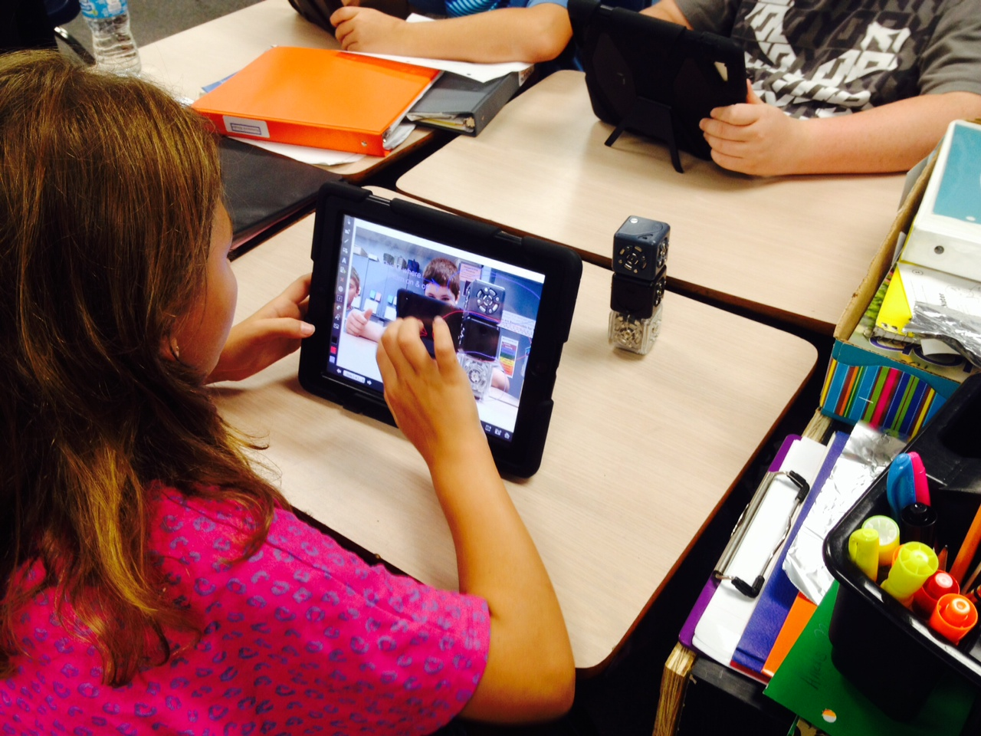
What is STEM?
Science
Technology
Engineering
Mathematics

Slide 3
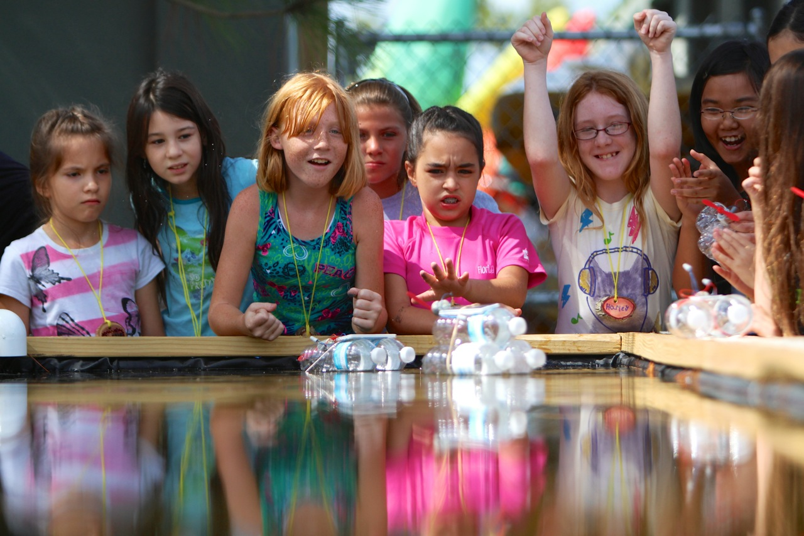
Why a STEM Fair?
Providing students opportunities to make meaningful connections to the real world is critical as we develop the skills, behaviors, and dispositions necessary for college, career, and life readiness.
Developing a S.T.E.M. (Science, Technology, Engineering, and Mathematics) Fair investigation will provide students the opportunity to use science knowledge and skills just as scientists do in the real world.

Slide 4
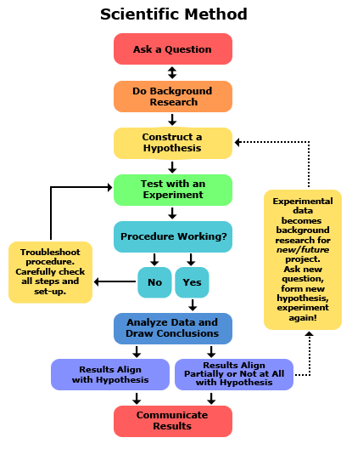
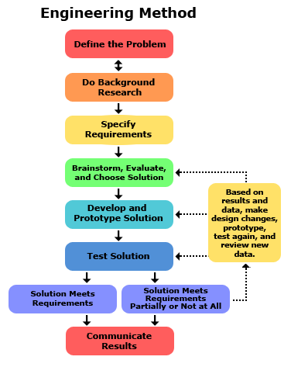
Comparing the Methods

Slide 5
Skills used in STEM Fair include:
Writing clearly
Communicating information effectively
Collecting and interpreting data
Using evidence to justify your thinking
Managing time
Providing opportunities to ask “why” leading to the development of an experiment or designing of a solution/innovation

Slide 6
Try to ask questions rather than give answers:
Questions help place responsibility on your child.
Questions help explore the dimensions of the problem.
Questions draw solutions from your child.
Questions communicate trust and confidence.
Questions help develop your child’s thinking and problem solving skills.

Slide 7
Sample Guiding Questions:
Why?
How do you know that?
What do you want to happen?
What would happen if…?
What other things could you try?
Explain or assist in finding resources to explain concepts that are difficult to understand.

Slide 8
Research Plan
Provides clarification and guidance throughout your child’s investigations.
Helps your child stay organized
Your child will need to keep a project log or journal. This should include dates and notes of everything that is done and read in connection to the investigation as well as data collected.

Slide 9
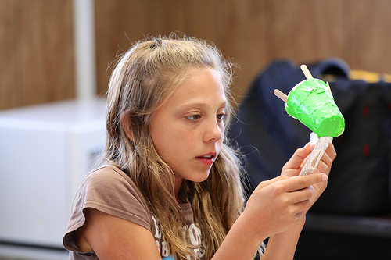
Getting Started: Choosing an Investigation
Your child needs to be excited about their investigation, guide them to investigate something they are interested in.
Research: Your child needs to gather information to help them develop their investigation

Slide 10
Example Question/Problem
Problem I am going to solve: “I am constantly losing things out of my pant pockets. How can I create a pant pocket that keeps items inside?”
This investigation has the student design/engineer something and then test it to help them solve their problem.
Question I am going to answer: “Which brand of diaper is the most absorbent?”
Notes:
Notice: This question is a good question which would allow students to go through the scientific process manipulating only one variable; the type of diaper.
This problem would allow the student to design a solution and test its effectiveness.

Slide 11
Example Hypotheses
Question: If I put 30 mL of water in the Huggies diaper, then it will absorb the most water because Huggies diapers have an extra layer of polyfiber material.
Problem: If I create a magnetic pocket casing, then I will lose fewer items out of my pockets because magnets provide a tight seal due to their characteristics.

Slide 12
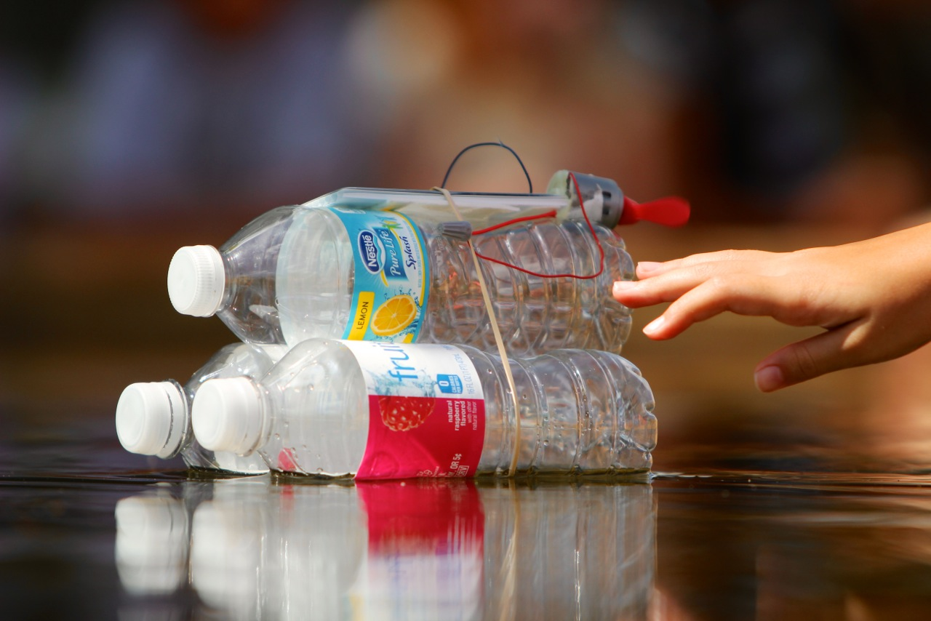
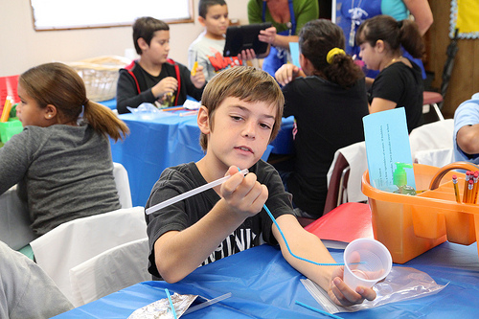
Putting It Into Action: Procedure
The purpose of the procedure is so other scientists and engineers can replicate your investigation. DETAIL, DETAIL, DETAIL.
Make sure to share all steps completed during the investigation and/or design of the solution.
It is okay if you begin your procedure and realize you may need to change something. This happens to scientists and engineers all the time.

Slide 13
Variables
A variable is a fancy word for things that you will be changing or keeping the same throughout your investigation. There are 3 types of variables:
Independent: The variable that will be changed
Dependent: The variable that will show an effect (what you are going to measure)
Constants: All the things that will be kept the same throughout the investigation to make sure it’s valid

Slide 14
Example Variables for Diaper Question
Independent: different brand of diapers that are being tested (Huggies, Pampers, Luvs)
Dependent: the amount of water absorbed (measuring using mL) by each brand of diaper
Constants: temperature of the water, location in the diaper in which water is poured

Slide 15
Example Variables for Pant Pocket Problem
Independent: different types of materials tested to create the pocket casing
Dependent: the number of shakes the pant pocket can withstand before losing its contents
Constants: same pair of pants and sized pocket, same items placed in the pocket casing

Slide 16
Collecting Data
As you investigate your problem be sure to collect data using a chart or table in your log or plan book
This will help you draw conclusions when you are finished with your experiment

Slide 17
Graphing Results: Communicating Our Data
Types of Graphs:
Bar- Compares different things
Line- Shows progress over time
Circle- Parts of a Whole
Make sure title and subtitles are labeled.
Number of paper towels
Number of Ounces Absorbed

Slide 18
Conclusion and Abstract: Putting It All Together
What did you learn from the experiment?
Did you prove your hypothesis?
Why-why not?
What problems did you have?
How is it applicable to real life?
What can the results be used for?
How can I use the knowledge I have gained from the experiment?
What would you do differently next time?

Slide 19
Safety and Display
The following items are not permitted to be displayed with your backboard:
Any glassware including containers that contain liquids
Any sharp items or edges. These could be hazardous to other students
Open flames or anything combustible
Mold regardless if it is in a container (Take Pictures)
No food (human or animal)

Slide 20
Abstract Guidelines
Abstract Guidelines
An abstract is a brief summary of your entire project. This is one of the most important things the judges will use to understand your project. Do not begin writing the abstract until your experiment is complete and you know your results and conclusions.
The abstract should be a one page typed description of the project (less than 250 words).
Must include a final draft three paragraph summary:
1st paragraph – tell what you did and why in your own words (this is a summary of your problem, purpose and hypothesis)
2nd paragraph – brief narrative description of how you did your experiment (paragraph explanation of basic procedures)
3rd paragraph – description of what happened in the experiment, why it happened, how it related to your hypothesis, and what you learned (summary of your results, data, and conclusions)
Abstract must be written in the correct format with the following information in the top left corner:
TITLE (name of your experiment written in all capital letters)
Name: your last name, first name, and middle initial (if you worked with a partner list name on next line)
School: River Ridge Middle School

Slide 21
Backboard Guidelines
Science Fair Entry Requirements
(must be completed if you want to be considered for science fair)
Include final copy of all parts of project, experimental design, and research (including the bibliography.)
Include Project log/journal with all rough draft research, data, and observations
Backboard Display:
Create a colorful, neat, and well-organized three-sided display. This is the first thing the judges will see and it will have a huge impact on the impression your project makes. You may make a backboard, buy one at a local store, buy one from school for $5.00, or borrow a used one to recycle.
Display MUST HAVE ABSTRACT MOUNTED IN BOTTOM LEFT CORNER.
Display should include: Problem, Purpose, Hypothesis, Materials, Procedures, Results (final draft graph), Conclusion, Extension and photographs or sketches showing results.
Display may be decorated with designs or pictures that enhance your project theme.
Display should be eye catching and professional looking.
No living tissue, bacteria, or chemicals may be on display.
Models may be displayed if needed to explain procedures or results.

Slide 22
STEM Fair
Our STEM Projects are due in classes by November 9th for 6th and 8th grade and November 30th for 7th grade.
Our school fair will be held on December 6, 2018 for students selected from the class competition.
This will allow students selected to go to district the opportunity to fine tune their presentations prior to the district fair on February 2, 2019 at Thomas Weightman Middle School.
More information can be found at the following link: www.societyforscience.org/isef

