Slide 1
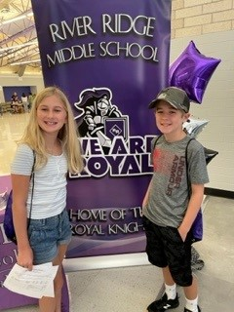
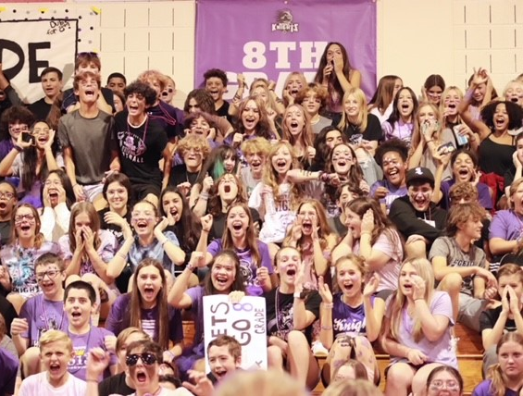
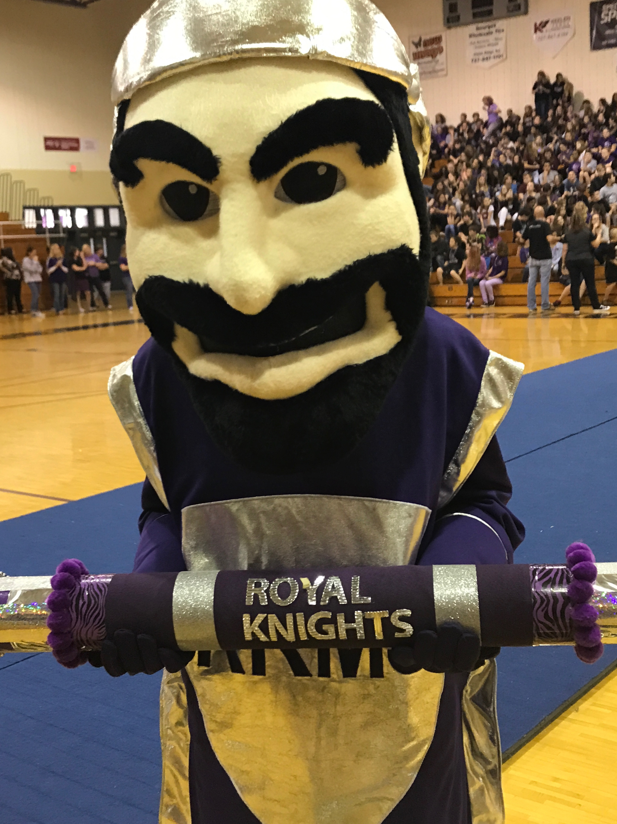
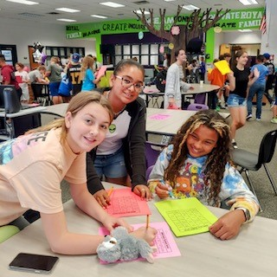
Welcome To the Royal Family!
#WeareROYAL
Notes:
Done

Slide 2
It’s ALWAYS A GREAT RIVER RIDGE DAY!
Notes:
done

Slide 3
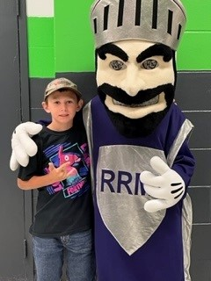
IMPORTANT CONTACTS
Angie Murphy, Principal
Kristen Martanovic, Assistant Principal for Articulation & Scheduling & Class of 2030
Monica Stanton, School Counselor 2030
Gina Thompson, ESE Lead
Nicole Hawks, Gifted Lead
April Addington, SSAP
Debbie Sarris, Registrar
Notes:
done

Slide 4
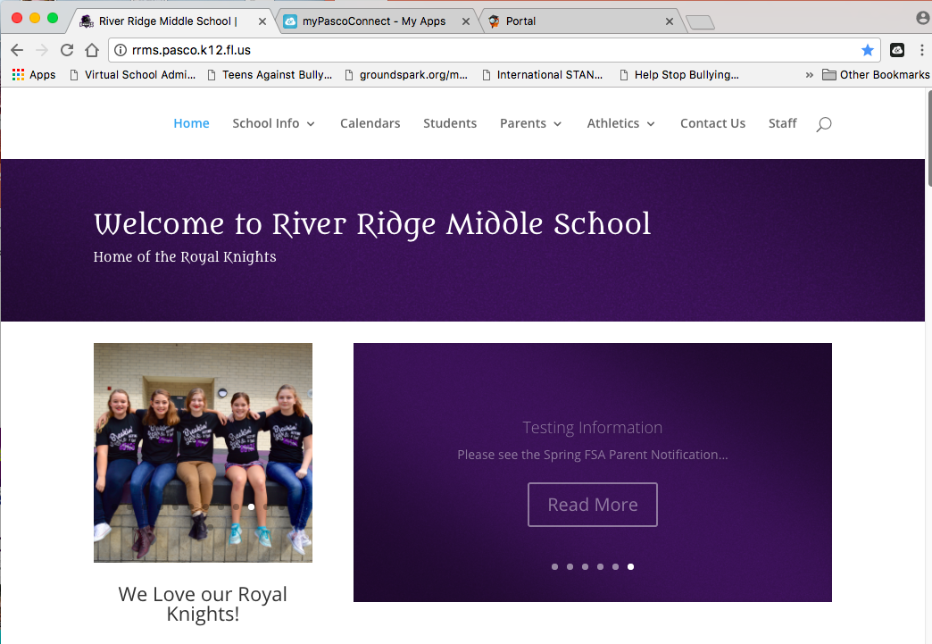
CONNECT with RRMS
Follow us:
@RRMSRoyalKnight
https://www.facebook.com/
riverridgemiddle/
Check out our website:
rrms.pasco.k12.fl.us
Notes:
Done

Slide 5
RRMS PTSA
SIGN UP TODAY: https://riverridgemsptsa.memberhub.store/store

Slide 6
THE RIVER RIDGE EXPERIENCE
-We believe that with the right supports that ALL students have the ability to meet high academic standards through challenging course work.
-We have a caring & respectful Royal Family who works together so that everyone will succeed!
-All 6th graders have 6 classes. All 6th graders will take Research or Reading, Health, and PE or an elective of his/her choice (if parent completes the PE waiver).
Notes:
done

Slide 7
THE RIVER RIDGE EXPERIENCE
-6 Periods/6 Classes & "Knight Time”/Lunch
-Daily “Knight Time” for students to go for the WIN (What I Need) - 20 minutes per day in different class periods to complete make up work, take advantage of second change learning opportunities (SCLO), re-teaching, and intervention time.
-Academic Lunch & after school tutoring for students to get help with challenging coursework.
Notes:
Need to check times

Slide 8
Notes:
done

Slide 9
6th Grade Schedule
Advanced U.S. History
Advanced Language Arts
Advanced Science* or Acc Science Honors*
Math or Adv 6 Math* or Adv 7 Math*
Research
PE/Health or Semester elective (PE Waiver)
*Teachers will initial course card for Advanced/Acc. Math and Acc. Science Honors.
Notes:
done

Slide 10
Math Course Progression
Teacher will recommend for Advanced & Accelerated Math
with a signature on the Course Card.
9th Grade Year
Geometry
Honors
9th Grade Year
Algebra 2
Honors
9th Grade Year
Algebra 1
Algebra 1
Honors
8th Grade Year
Pre-Algebra
8th Grade Year
8th Grade Year
Geometry
Honors
7th Grade
Adv. Math
7th Grade Year
Algebra 1
Honors
7th Grade Year
7th Grade Math
7th Grade Year
6th Grade Year
7th Grade
Adv. Math
6th Grade
Adv. Math
6th Grade Year
6th Grade Math
6th Grade Year
6th Grade
Adv. Math
ELEMENTARY
APRIL-AUGUST
ONLINE
ELEMENTARY
5th Grade Math
ELEMENTARY
5th Grade Math
5th Grade Math
Traditional
Pathway
ADVANCED
PATHWAY
ACCELERATED
PATHWAY
Notes:
done

Slide 11
Acceleration options
mathematics
6th grade Advanced Math will learn 6th and half of the 7th grade standards. These students will take the 6th grade math FAST.
7th grade Advanced Math will learn the rest of the 7th and 8th grade standards. These students will take the 8th grade math FAST.
Elementary teachers are very aware of their students’ successes. Teacher recommendation based on observations, interactions, MAP NWEA, FAST, and current academic success. We value your guidance.
Notes:
done

Slide 12
Summer math acceleration program
In partnership with Pasco eSchool, we are proud to present the option of a summer math acceleration program for incoming RRMS students. Students will take 6th Grade Advanced Math from April – August with Pasco eSchool then be enrolled in 7th Grade Advanced Math as a cohort.​
Contact Pasco eSchool to sign up today!
Notes:
done

Slide 13
Science Course Progression
Teacher will recommend for Accelerated Science with a signature on the Course Card.
STUDENTS MUST ALSO TAKE ADVANCED MATH OR ACCELERATED MATH OPTION
9th Grade Year
Physical Science
Or Biology Honors
9th Grade Year
Biology 1 Honors
8th Grade Year
Physical Science
Honors*
8th Grade Year
8th Grade Adv.
Science
(FSAA State
Science Assessment)
7th Accelerated
Science 2 Honors
(All of 7th &
Sem. 2 of 8th)
7th Grade Year
(FSAA State
Science Assessment)
7th Grade Year
7th Grade Adv.
Science
6th Accelerated
Science 1 Honors
(All of 6th &
Sem. 1 of 8th)
6th Grade Year
6th Grade Adv.
Science
6th Grade Year
ELEMENTARY
5th Grade Science
ELEMENTARY
5th Grade Science
Traditional
Pathway
ACCELERATED
PATHWAY
Notes:
done

Slide 14
Acceleration options
Accl. Science honors
This course will differ from Advanced coursework in the pacing of the course will be FASTER and the depth of material covered will be greater.
Science 1: 42 Standards (7 Unique); Accel 1 Honors: 60 Standards (18 Unique)
6th Grade- Cover all 6th grade standards and part of 8th grade standards (Physical Science)
7th Grade- Cover all 7th grade standards and part of 8th grade standards (Earth & Space, Life)
8th Grade- Physical Science Honors (high school honors course)
Criteria: FAST ELA Achievement Level 4, 5 (Grade 5), FAST Math Achievement Level 3, 4, 5 (Grade 5), Science Achievement Level 3-5, Teacher Recommendation, Advanced Math/ACC Science
STUDENTS MUST ALSO TAKE ADVANCED MATH OR ACCELERATED MATH OPTION
Notes:
done

Slide 15
PE REQUIREMENT
All students are required to take one semester of Physical Education in middle school every year (Senate Bill 610).
Dance course will also satisfy the PE requirement.
Students can choose to “opt out” of PE but parents must sign a PE waiver on the back of the course card.
Turn to the
Back of the Course Card
Notes:
done

Slide 16
Health Requirement
The Health Education Course is designed to enhance the awareness
and knowledge of HEALTHY LIFESTYLE CHOICES that promote
HEALTHY BEHAVIOR OUTCOMES. This course is required for all Pasco County 6th grade students. Students wishing to take the FULL YEAR elective or TWO SEMESTER electives option may take this course through Pasco eSchool. This course satisfies the Career Component which is a promotion requirement.
Turn to the
Back of the Course Card
Research
The purpose of this course is to enable students to develop basic knowledge and skills in the research process with emphasis on determining and refining research questions. The content should include, but not be limited to, the following: -research process, research topics, research questions and hypotheses, definition, analysis, and evaluation of research questions, review of literature and other resources, directed investigations, critical analysis of research, and the National History Day Fair Project.
Notes:
done

Slide 17
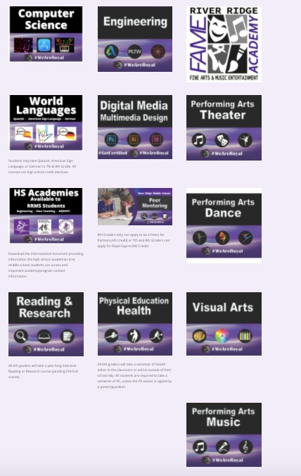
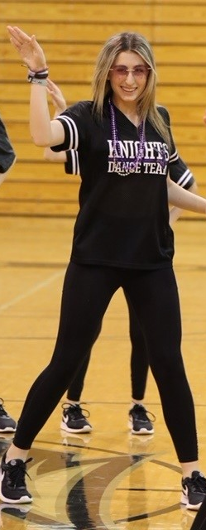
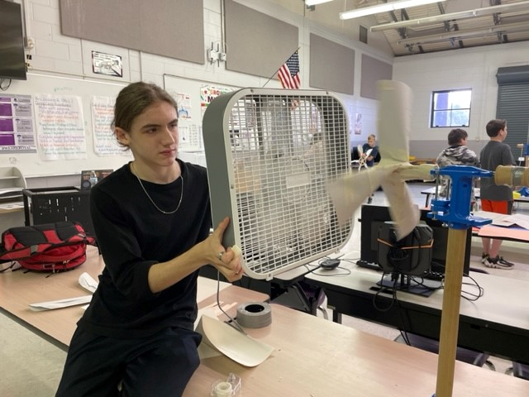
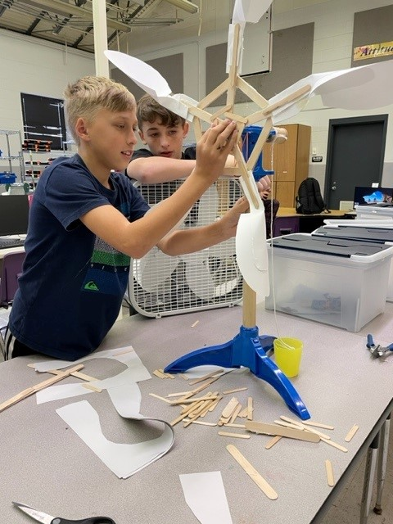
ELECTIVES & PROGRAM OPTIONS
•Visit the RRMS Website to explore all of the course offerings & elective options. There are course videos for each area.
•Website: rrms.pasco.k12.fl.us
Notes:
done

Slide 18
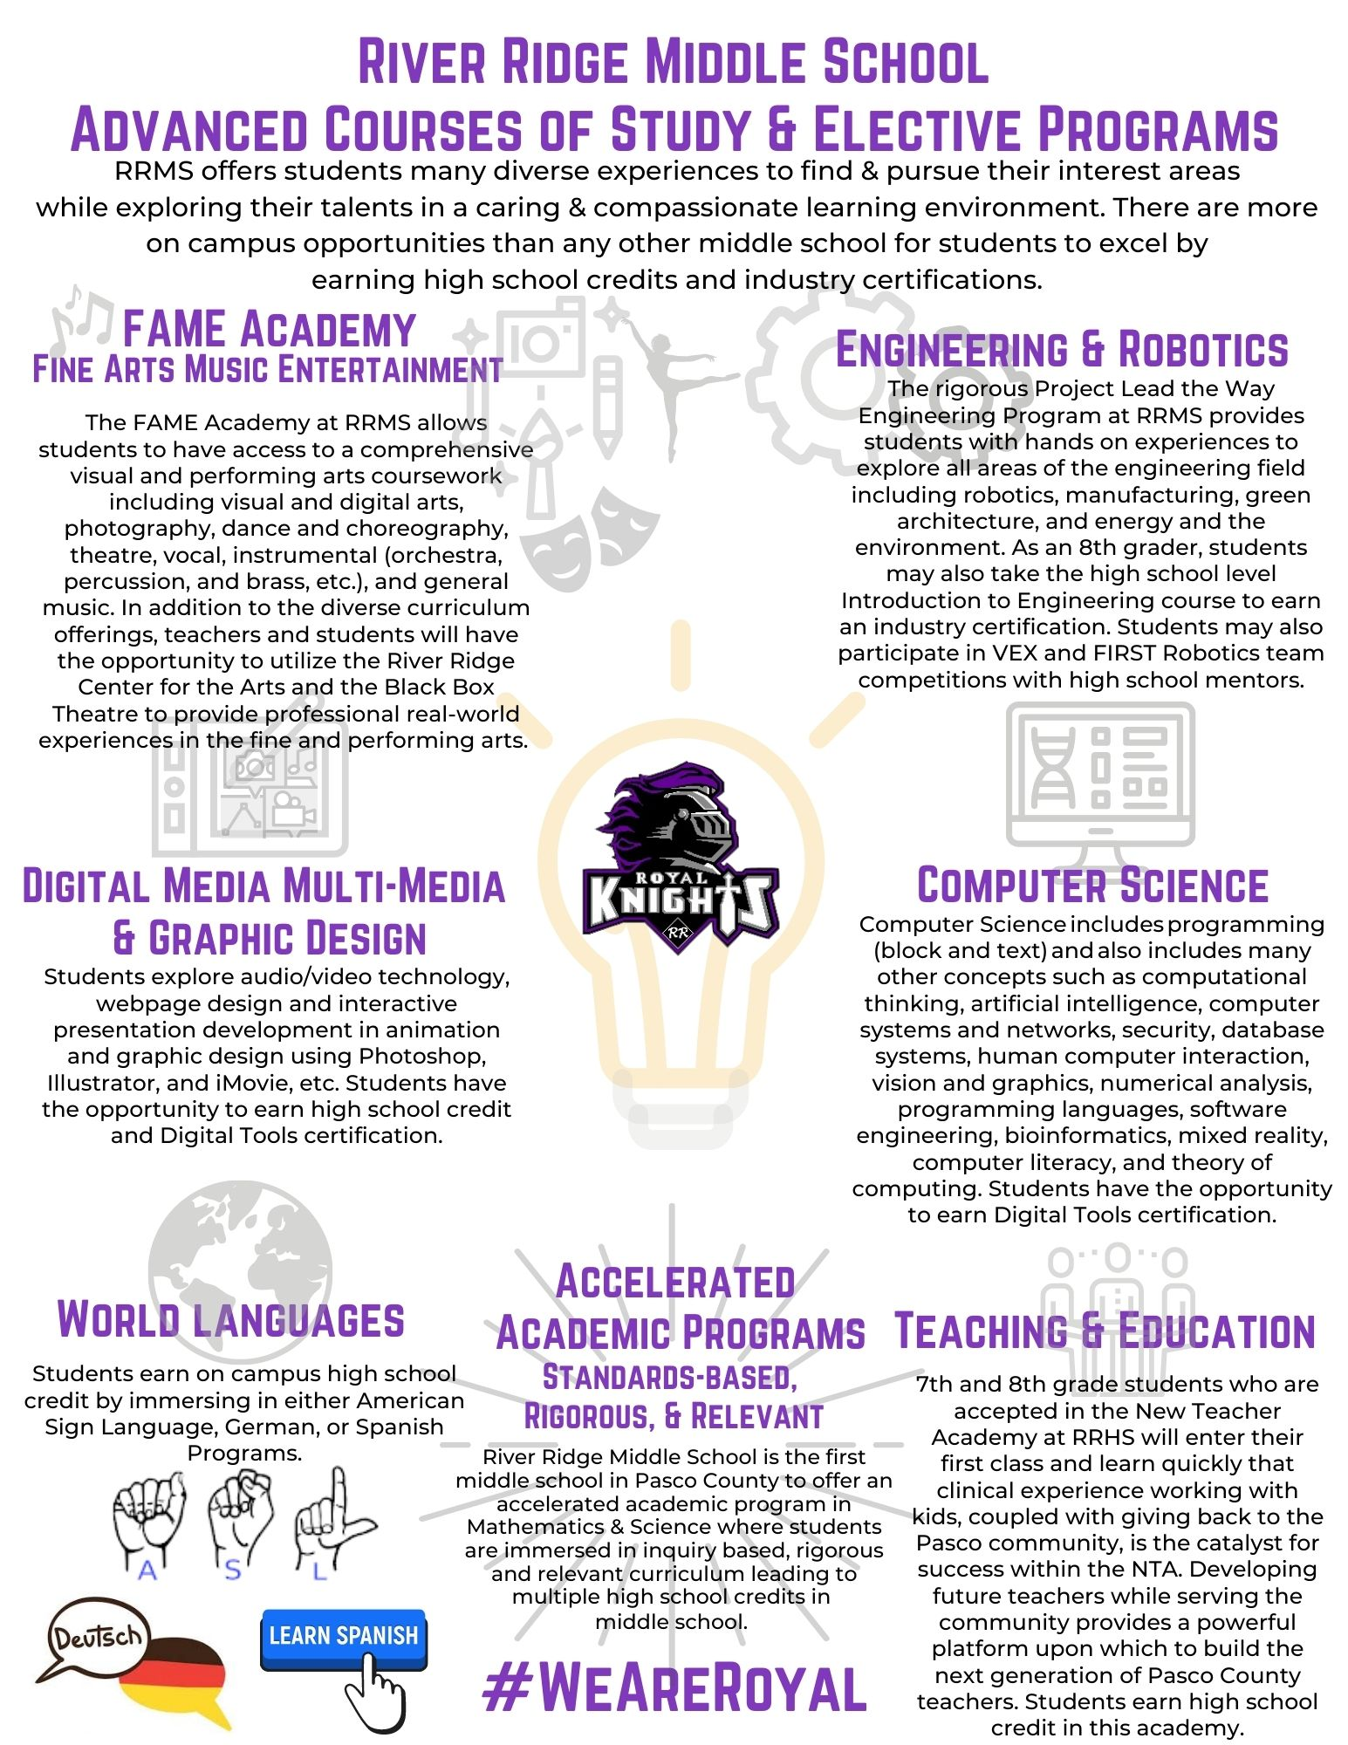
Notes:
done

Slide 19
ELECTIVE CHOICES
Notes:
done

Slide 20
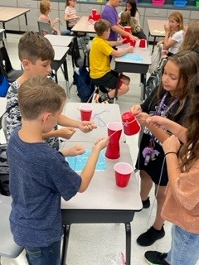
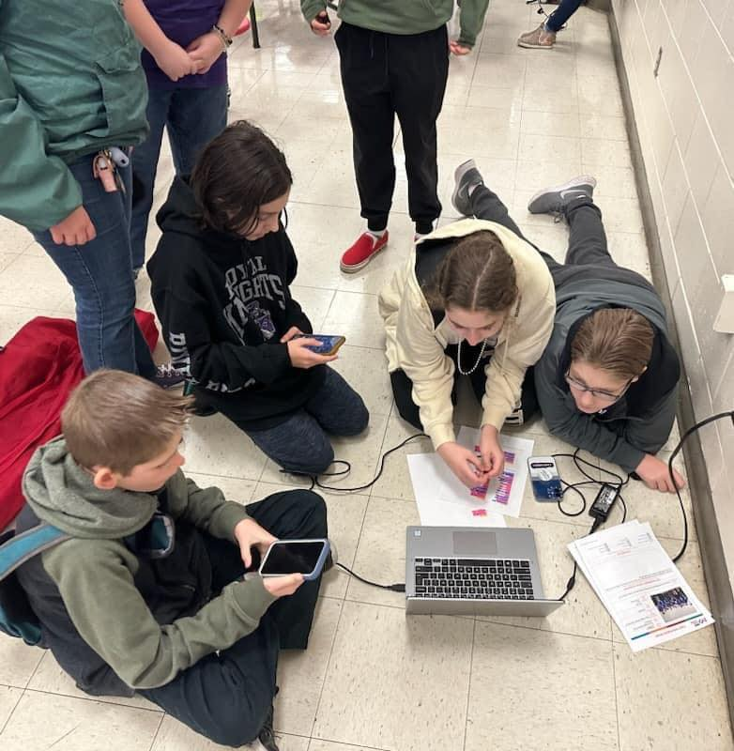
6th gr. Semester Elective Choices
Intro. to AV Arts* (Graphic Design)
Coding Fundamentals 1* and 2*
Computer Science Discoveries 1* and 2*
Engineering 1-Explor Tech Design*
Engineering 2-Automation/Robotics*
Exploring Art 2D or Art 3D
Intro to Dance (counts as a PE course)
Intro to Basic Theater
Intro to Technical Theater
Guitar 1 & 2
PE
*Industry Certification Course – Digital Tools
Notes:
done

Slide 21
6th gr. Yearlong Electives
Turn to the
Back of the Course Card
Band 1 or Chorus 1 or Orchestra 1
Students who take a YEAR LONG or 2 SEMESTER ELECTIVES must sign the Health agreement to take health online when available outside of their school day.
ALL students must also complete a PE waiver.
Online M/J Health DOES NOT satisfy the Career Component. Students MUST complete a separate set of modules to be eligible for promotion.

Slide 23
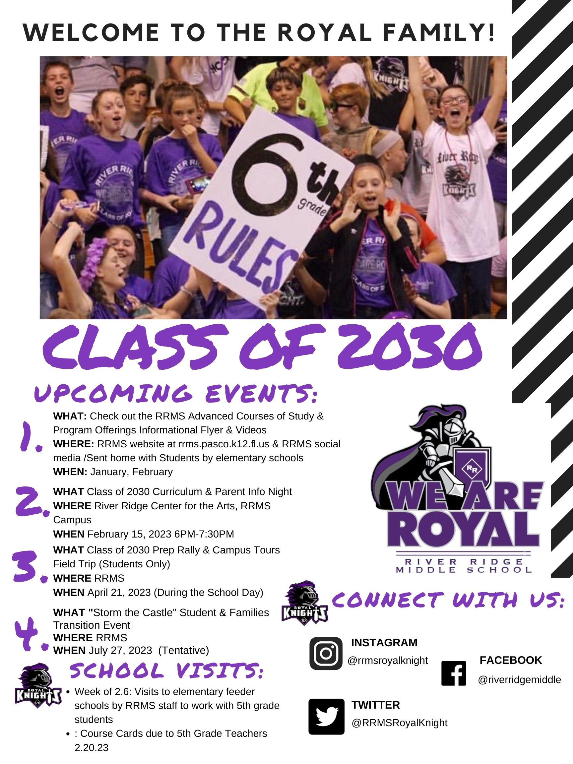
Notes:
Need all new info

Slide 24
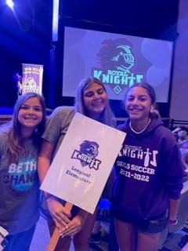
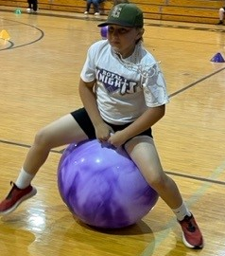
THE RIVER RIDGE EXPERIENCE
RRMS Campus Tours & Prep Rally
Field Trip
Bus Transportation will be provided to feeder schools.
April 21
10:30AM-12:30PM
Notes:
dobe

Slide 25
THE RIVER RIDGE EXPERIENCE
We are planning a field trip to RRMS in April for campus tours, pep rally and a student panel.
-Monthly student clubs based on your interests
-Sports in 6th Grade
-Cheerleading, Football, Track,
Soccer, JV Volleyball, JV Basketball, Dance Team
-Service Clubs, Royal Merchant School Store, Royal Rewards…

Slide 26
THE RIVER RIDGE EXPERIENCE
Don’t forget to give us your t-shirt size!
Finally, SIGN THE
COURSE CARD (Parent & Student signature REQUIRED).
August 1, 2018
8:30AM-1PM
Begin your journey as a Royal Knight by attending this special orientation.
July 27, 2022
8AM-12PM
Notes:
dobe

Slide 27
Common middle school ?s
Lunch
Navigating the Castle
Making Friends
Getting Involved
Homework
Riding the Bus
Independence
Notes:
Done

Slide 28
Common middle school ?s
Lunch
Navigating the Castle
Making Friends
Getting Involved
Homework
Riding the Bus
Independence
Notes:
Done

