Slide 1
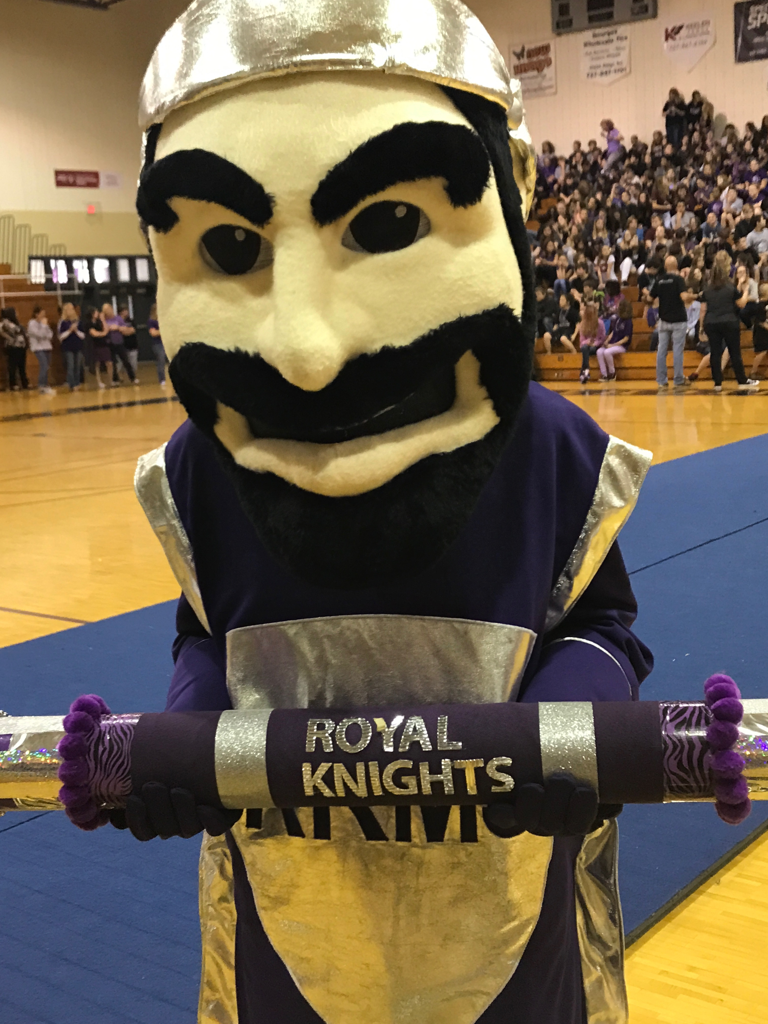
River Ridge Royal Knights Share These Knightly Values:
ROYAL TOWN HALL
Be Respectful
Be Responsible
Be A
Problem Solver
#WeareROYAL

Slide 2
KNOW YOUR KNIGHTS

Slide 3
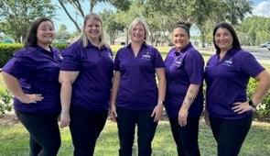
RRMS ADMINISTRATION
Ms. Grubbs (8th), Ms. Martanovic (6th), Mrs. Murphy (Principal), Ms. Sumrall (8th), Ms. Brissey (7th)

Slide 4
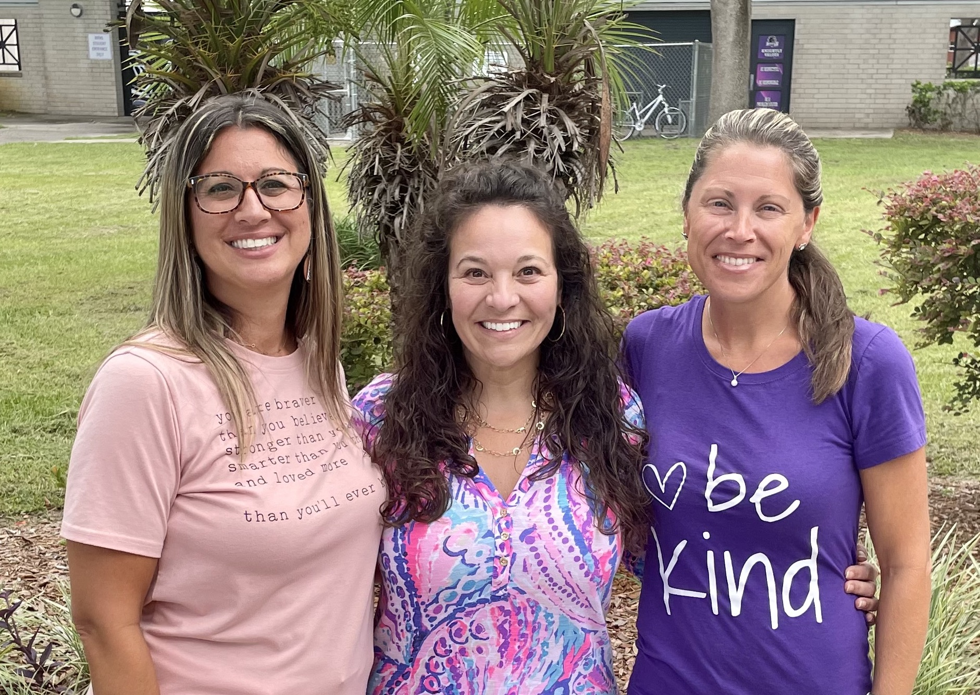
RRMS
SCHOOL COUNSELORS
Ms. Alston (8th), Mrs. Stanton (6th), Mrs. Doerrfeld (7th)

Slide 5
RRMS SUPPORT STAFF
Student Support Assistants
Mr. Corley (7th Grade)
Mrs. Sestokas (8th Grade)
Mr. Kidwell (6th Grade)
Mr. Koubek
Mrs. Costlow & Mrs. Owens
School Social Workers
Mrs. Addington & Mrs. Blanchard
(SSAP)
Ms. Noe & Ms. Theisen
(Clinic Asst. & School Nurse)
Corporal Peters (MS)

Slide 6
WHAT IS THE ROLE OF THE
ADMINISTRATOR?
Report a problem
Resolve Peer issues
Help with communication with a teacher
Good Knight Shield of Honor Positive Calls Home
Have the teacher call the front office to meet with an Administrator and if your Administrator isn’t available, complete an incident report/make an appointment to see them.

Slide 7
WHAT IS THE ROLE OF THE
SCHOOL COUNSELOR?
They provide students with personal, social, academic, and career counseling.
Report a problem
Resolve Peer issues
Help with communication with a teacher
Mental health support
Sign up for Online Classes
Get a pass to visit and if your counselor isn’t available,
use the QR Code to make an appointment.

Slide 8
PROMOTION REQUIREMENTS
ALL students need to take and pass with a D or better:
3 math
3 science
3 ELA
3 social studies, including civics and sit for Civics EOC (30% of grade)
Failed courses will need to be retaken through recovery
ALL students need to do Career Planning Module
6th grade through Health, 8th grade through social studies

Slide 9
ARE YOU TAKING
HIGH SCHOOL CREDITS?
High School Classes count for HS GPA
Allows you to earn HS credit now to take DE or AP later-$$$$
Must maintain a B or better on every progress report and report card
Must complete all assigned work and use available resources if you need help
Limited options if need to be removed

Slide 10
ROYAL EXPECTATIONS
Be Respectful. Be Responsible. Be a Problem Solver.
Student Code of Conduct
Dress Code
Attendance
Wireless Device Policy
Zero Tolerance Policy

Slide 11
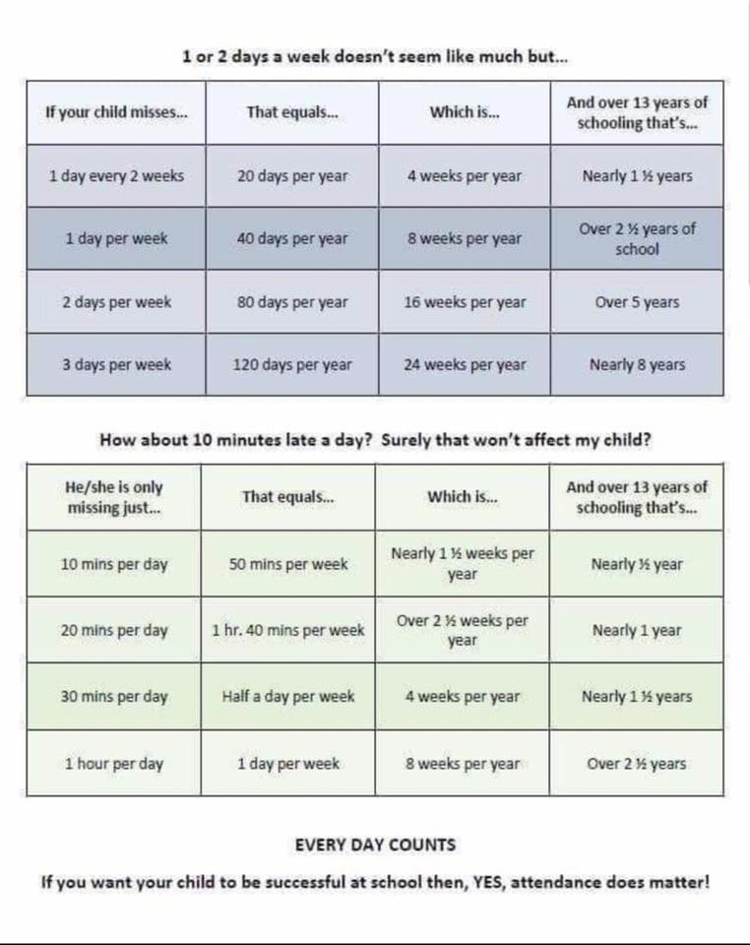
Notes:
Grade level Admin

Slide 12
ROYAL EXPECTATIONS
Safety is our #1 Priority.
Work at “getting along” and keeping hands, feet, and objects to ourselves
Respect is the key!
Show respect to others, and they will respect you!

Slide 14
BULLYING VS. PEER CONFLICT
Peer conflict is a disagreement or opinion difference between students with equal power. They often are remorseful and willing to work out differences.
Bullying is behavior repeated over time where there is an imbalance of power between two parties.
The person who bullies intends to inflict harm on the person or target (physical or emotional).
The bully is not remorseful for their actions.

Slide 15
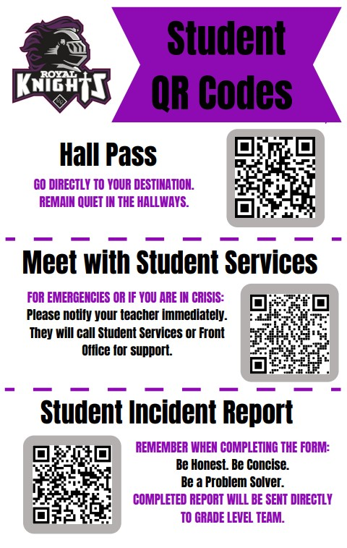
SEE/HEAR SOMETHING,
SAY SOMETHING
You may also come to the front office to complete an incident report for Corporal or Administration.

Slide 17
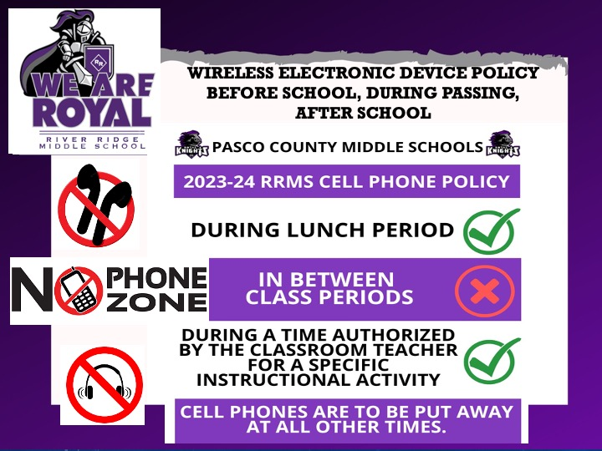
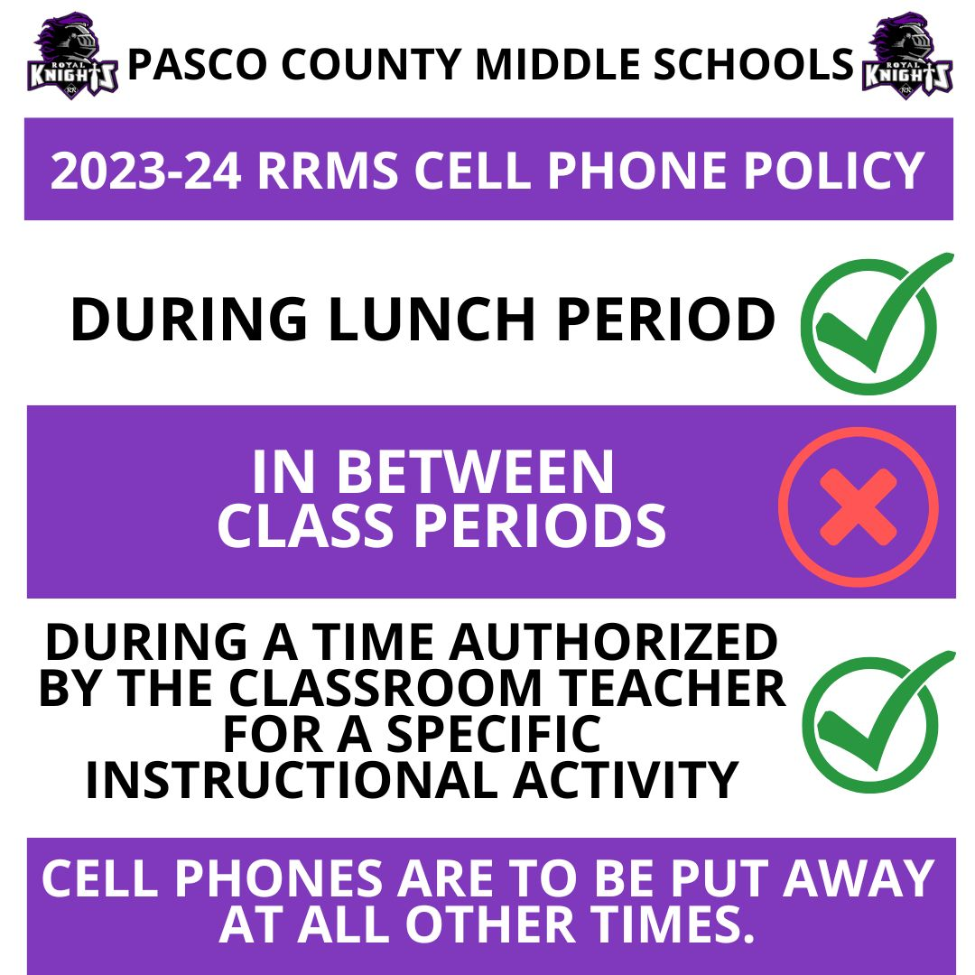

Slide 18
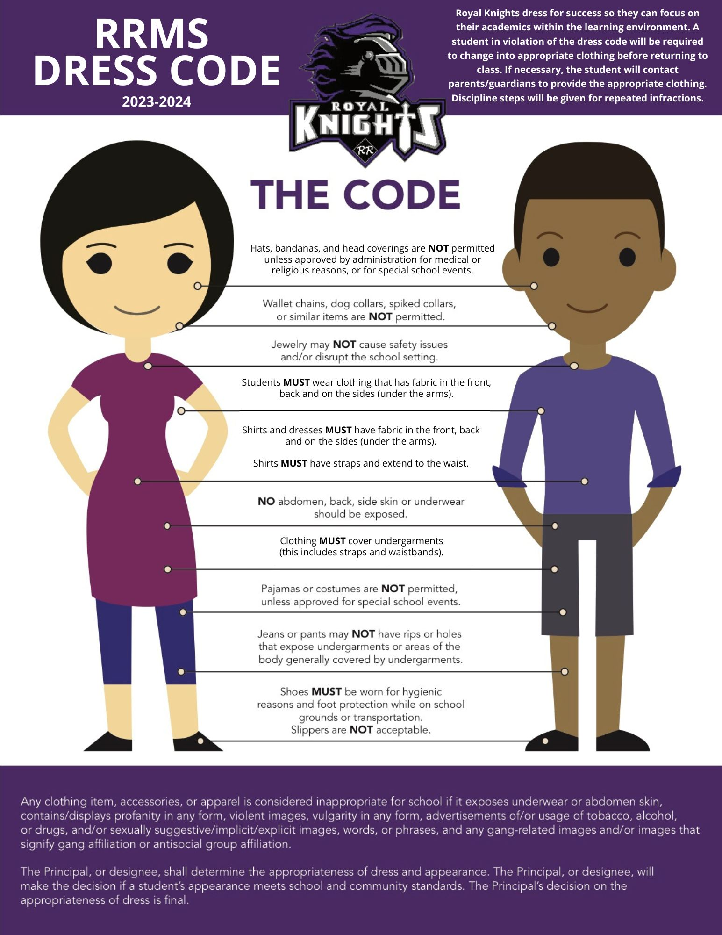

Slide 19
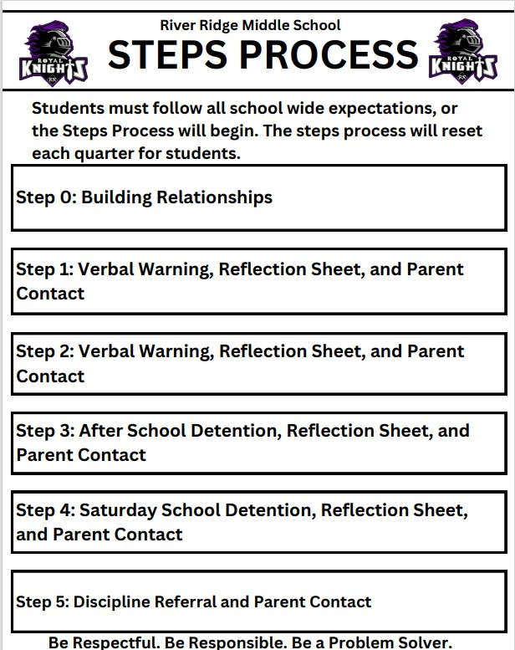

Slide 20
Notes:
Baumaister/Admin.

Slide 21
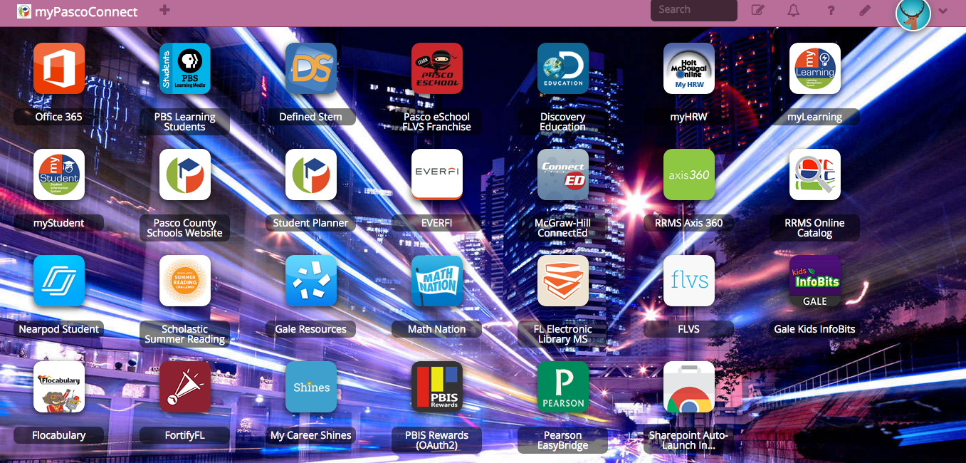
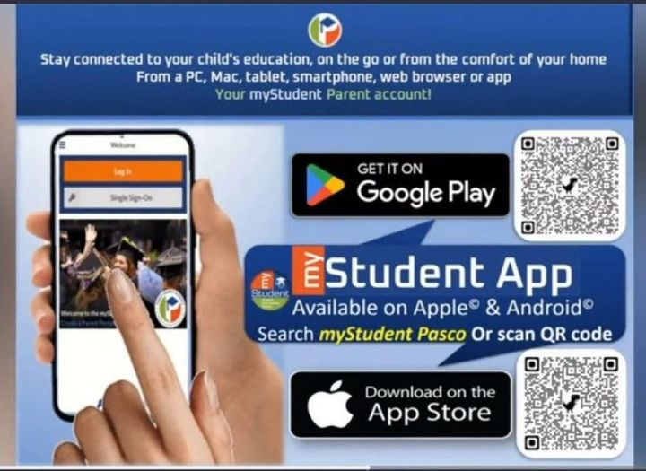
STAY CONNECTED… OWN YOUR LEARNING
myPascoConnects
LOG IN:
Username: Student #
Password: Password you
use for everything
(word, number, symbol)
MySTUDENT APP
Notes:
Baumaister/Admin.

Slide 22
GET INVOLVED!

Slide 23
Monthly ENRICHMENT ACTIVITIES
All students will pick an enrichment activity they can participate in each month (starting in September).
These activities will occur during the school day once a month on the Early Release Days so everyone can be included. Dress appropriately for your activity.
Students and teachers can have fun exploring new hobbies.
Meet new friends that share your interests.
Activity selection will be August 21-25 at lunches.

Slide 24
After school clubs
National Junior Honor Society (Application period in April) - Mrs. Wierenga
Student Council (Application & election) – Mr. Corley
Thespians – Mr. Bintz

Slide 25
Student council

Slide 26
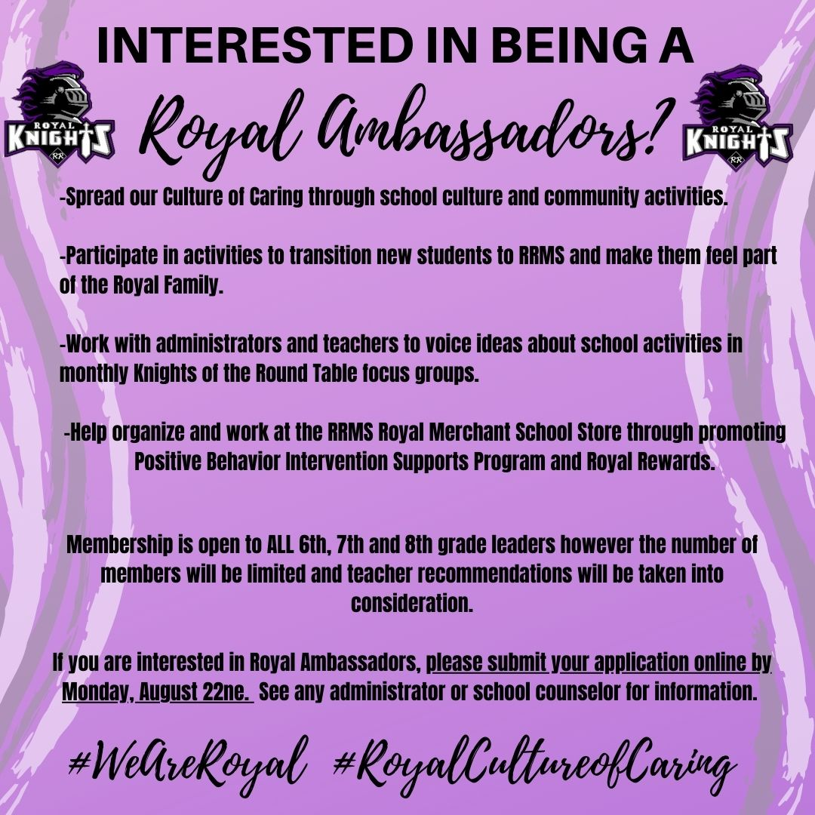
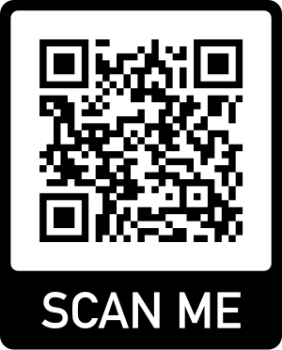
Royal ambassadors

Slide 28
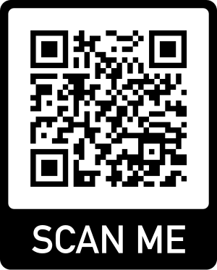
WE WANT TO HEAR FROM YOU!
What would motivate you to make the right choices at school continuously?
What incentives could you earn when displaying our Knightly Values?
What enrichment activities are you interested in?
COMPLETE THE STUDENT INPUT FORM!

